Slide 1
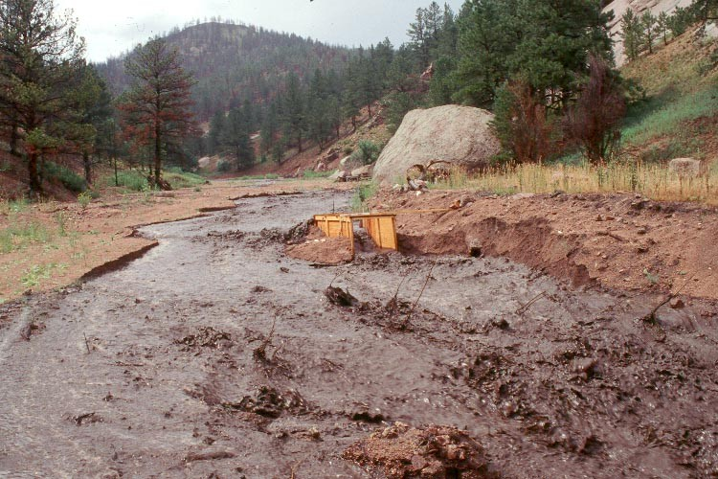
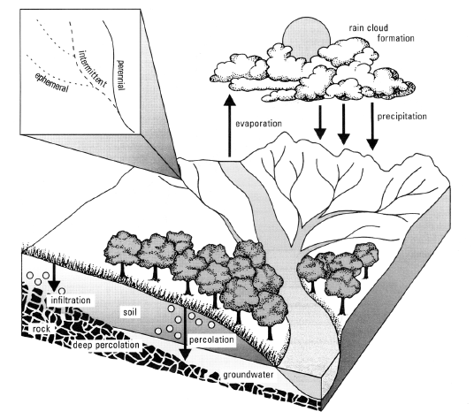
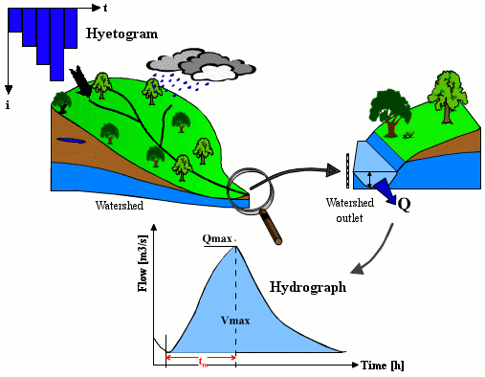
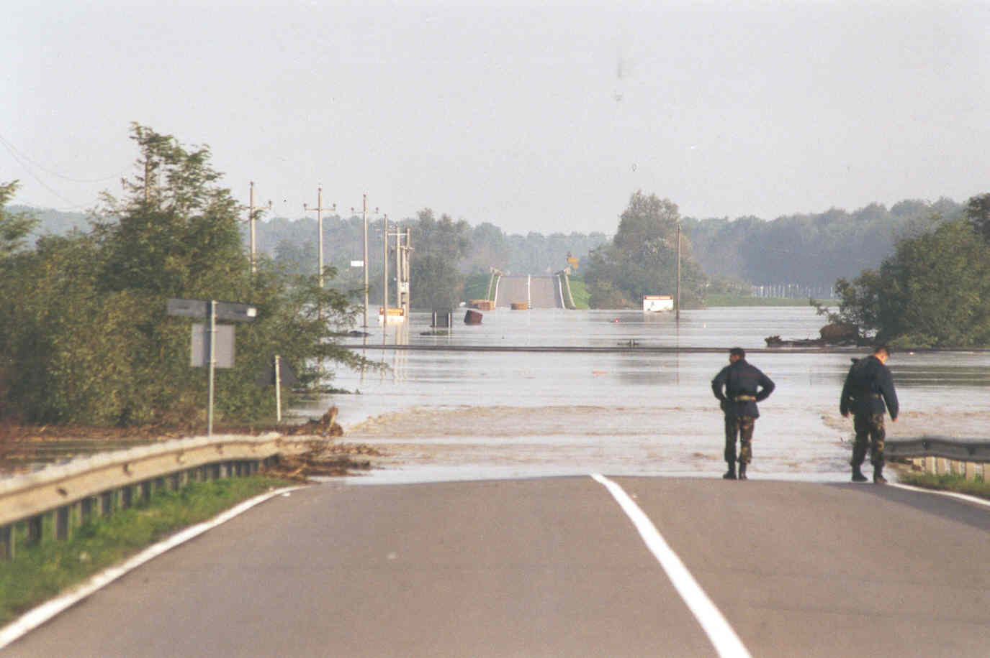
Model calibration and validation
Alberto Montanari
University of Bologna

Slide 2
Why hydrological models need to be calibrated?
Parameters:
A parameter is a constant or variable term in a function that determines the specific form of the function but not its general nature, as a in f (x) = ax, where a determines only the slope of the line described by f(x).
Parameters might be present in fully physically-based equations (physical properties can be considered as parameters) but usually the term parameter is reserved for quantities that are not physically measurable and compensate for approximations in physical equations.

Slide 3
Why hydrological models need to be calibrated?
Hydrological models only provide an approximation of the underlying actual processes. Therefore they exhibit a certain degree of conceptualisation and parameters are not physically measurable.
Calibration allows us to “adapt” model equations to specific case studies and applications.
Calibration is usually performed by “adapting” the model output to observed data. However, it is possible to calibrate models also basing on personal experience and perception of the processes.

Slide 4
Calibration procedures
Manual calibration: trial and error, perceptional
Automatic calibration
- Optimisation algorithms
- Evolutionary algorithms
- Genetic algorithms (Genoud in R)
Need to define an objective function to automatically quantify the goodness of the fit.

Slide 5
Objective functions
Least squares
Nash-Sutcliffe efficiency
Correlation coefficient

Slide 6
Objective functions
These are quadratic measures
Mean relative error

Slide 7
Calibration problems
Overfitting
Equifinality
Correlation among parameters
Need to use all the available information
Multiobjective calibration
Non dominated solutions and Pareto fronteer

Slide 8
Model validation
Calibration assures the best fit of the observed data. It does not give any indication about model performances in real world applications.
Need to check how the model works with out-of-sample applications.
Split sample calibration and validation.
Jack-knife validation

Slide 9
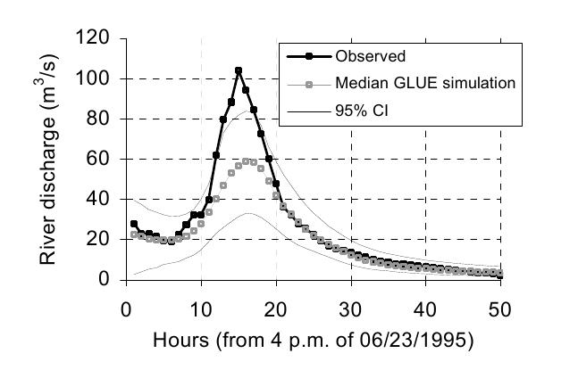
Visual comparison between observed and simulated data
Graph of observed vs simulated hydrographs

Slide 10
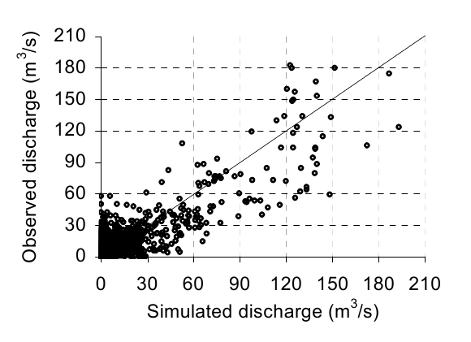
Visual comparison between observed and simulated data
Scatterplot of observed vs simulated hydrographs

Slide 11
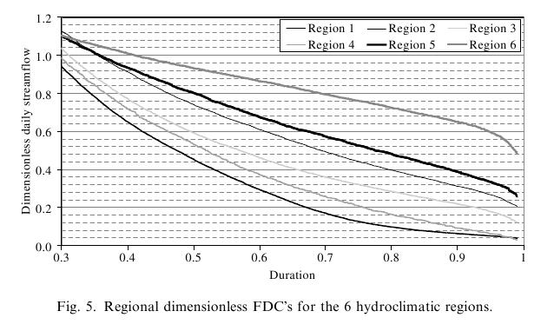
Visual comparison between observed and simulated data
Comparison of observed vs simulated flow duration curves
Flow duration curve: a graph showing observed river flows in the Y ax versus the average time span in a year during which each river flow observation was equalled or exceeded. Usually estimated by using daily data

Slide 12
What is a good model?
Difficult to say but:
- Nash efficiency in the range 0.6-0.9
- Correlation coefficient in the range 0.8-0.99
- Mean relative error in the range 15% – 40%
- Mean relative error in the simulation of peak flows in the range 10% - 25%
- No evidence of significant model structural inadequacy for different river flow regimes.

